Slide 1
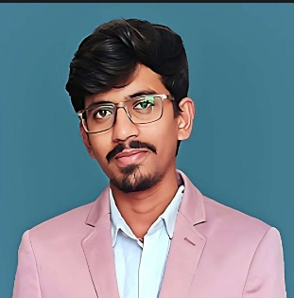
Srujan Kumar Reddy Pathapati
Associate Software Engineer | Technology Consulting
Functional/Technical competencies to be highlighted:
Functional | Banking
Technical | Micro Services using .NET Core, Angular, Azure, APIM, Azure SQL, Azure Developer.
Mobile :
+91 6304668491
Email :
srujankumar2306@gmail.com
Background
Experience
Projects
Srujan Kumar Reddy Pathapati is working in Ernst & Young as Associate Software Engineer from 2022.
Over 1.5 years of experience in Application Support and Enhancing enterprise applications, Testing in EY.
Hands on experience in .NET Core, ASP.NET MVC, ASP.NET, Entity Framework Core, SQL Server , Postman.
Education: Bachelor of Technology in Electronics and Communication.
Certification: AZ900.AZ104
Strong in C# .NET Programming Skills.
Strong knowledge on SQL Programming language for Microsoft SQL Server.
Good in Problem Solving Skills.
Strong in Application Development with exposure to ASP.NET/ASP.NET MVC, C#, SQL Server, Python, HTML and CSS.
Experienced in creating databases, tables, writing Stored Procedures, Cursors, User Defined Functions, Complex queries, joins, Performance Tuning and Optimizing SQL Queries.
Worked as an Application Support Engineer for an Open Banking client based out of Australia.
Contributed in developing an accelerator based on client requirements using ASP.NET MVC.
Performed code analysis & review.
Australia Based Banking Company :
In this project the accounts and data across institutions used for by consumers, financial institutions, and third-party service providers.
Technologies: Micro services using .NET Core, Angular, Azure, APIM, Azure SQL, Azure Developer.
Skills
Languages: C#, Java, C, Python
UI: HTML 5, CSS
DB Tools: SQL Server
Cloud: Azure .
Application/server: .NET, ASP.NET, MVC
IDE/Editor : MS Visual studio, MS Visual Studio Code.
Tools/ Productivity: POSTMAN, GitHub.

